Slide 1
Scientific Machine Learning for Modeling and Control of Data Centers
Ján Drgoňa
Associate Professor Civil and Systems Engineering Department The Ralph O'Connor Sustainable Energy Institute (ROSEI)
Data Science and AI Institute (DSAI)

Slide 2
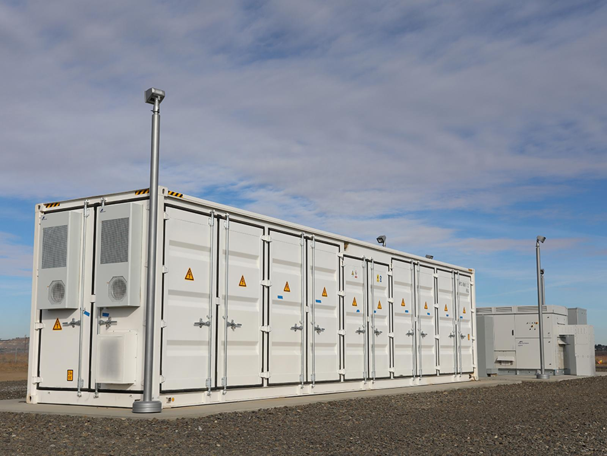



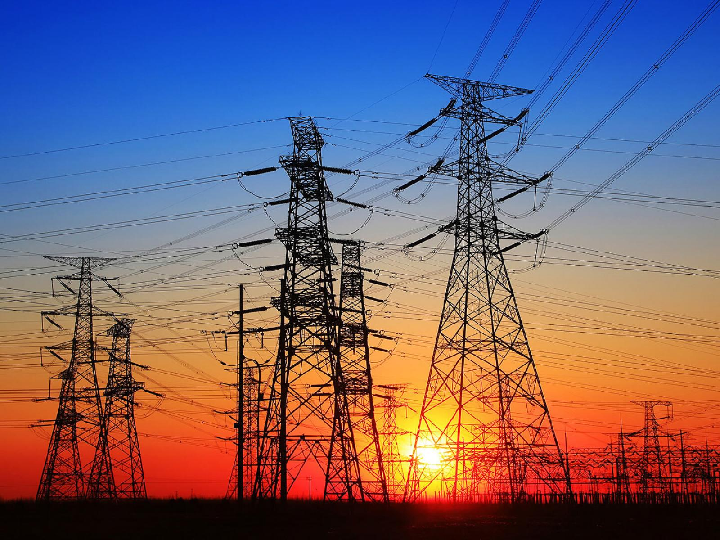
Optimizing Complex Energy Systems is Hard
Simulations are crucial for optimal decision-making in complex energy systems
Need: Improve computational efficiency and scalability of digital twins and optimization-based decision-making
Challenges:
Modeling and simulation of complex systems is hard
Closed-loop control of complex systems is hard-er
Scientific computing and machine learning tools are fragmented and not easily composable

Slide 3
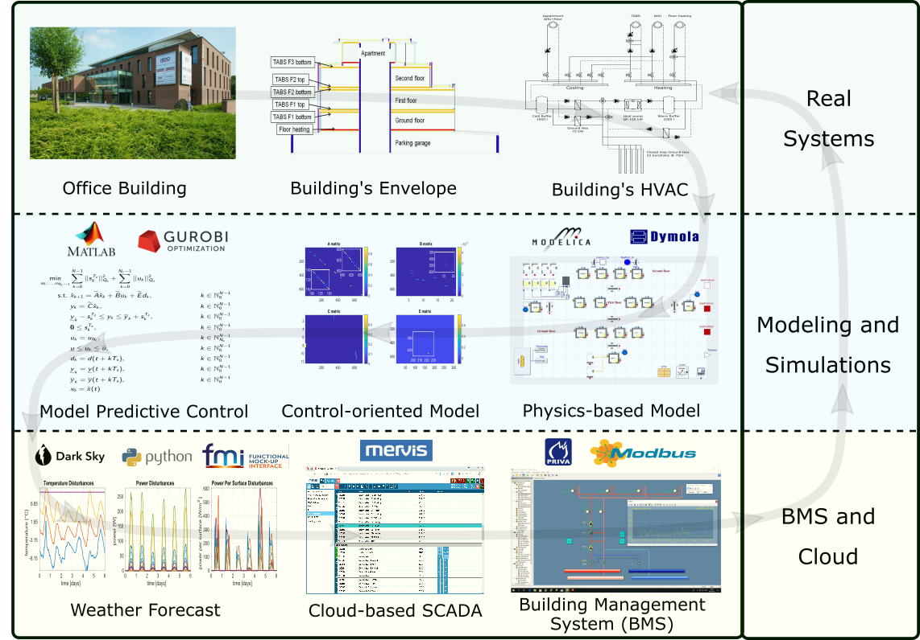
Example: Optimal Control of Building Energy Systems
Motivation
Buildings today contribute to approximately 40% of the global energy use.
Existing control solutions governing building energy systems are very inefficient.
Drgona J., et al., Cloud-based implementation of white-box model predictive control for a GEOTABS office building: a field test demonstration. Journal of Process Control, 2020.

Slide 4
Example: Optimal Control of Building Energy Systems
Upside
Heat pump energy savings up to 53%.
Improvement of thermal comfort up to 37%.
Drgona J., et al., Cloud-based implementation of white-box model predictive control for a GEOTABS office building: a field test demonstration. Journal of Process Control, 2020.

Slide 5
Example: Optimal Control of Building Energy Systems
Upside
Heat pump energy savings up to 53%.
Improvement of thermal comfort up to 37%.
Downside
Project duration: 1 year.
Expertise required: 6 staff with advanced engineering degree.
Drgona J., et al., Cloud-based implementation of white-box model predictive control for a GEOTABS office building: a field test demonstration. Journal of Process Control, 2020.

Slide 6
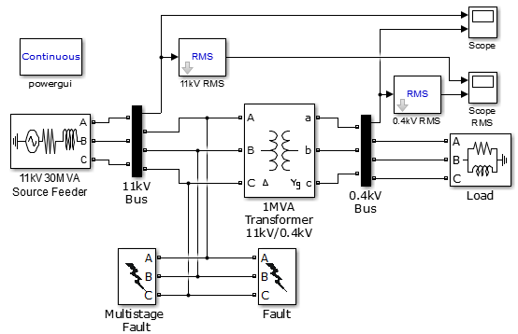
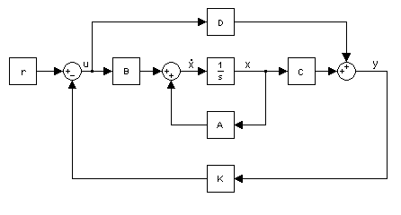

Challenge 1: Heterogenous Modeling Methods
White-box models
Gray-box models
Black-box models
Physics-based
Data-driven
More domain knowledge
Less domain knowledge

Slide 7

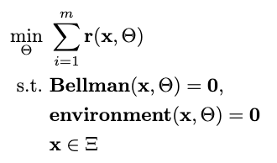

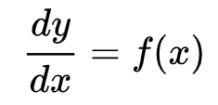

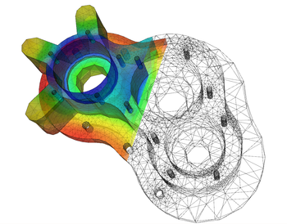
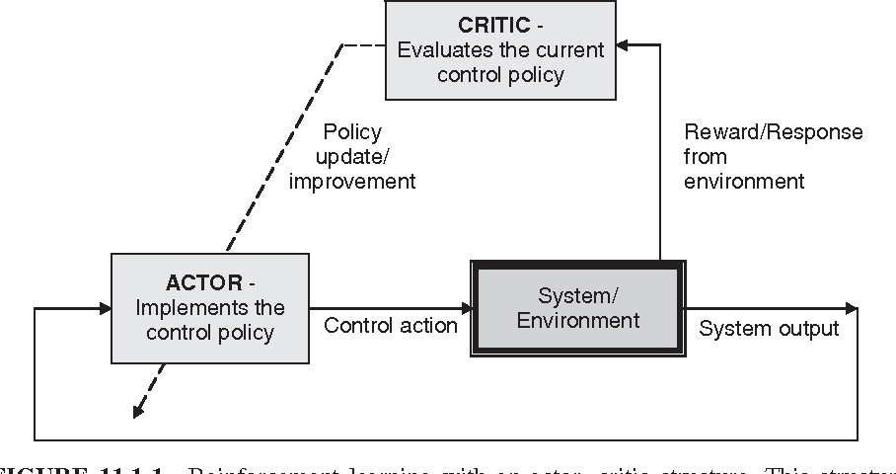

Challenge 2: Heterogenous Solution Methods
Constrained Optimization
Differential Equations
Supervised Learning
Reinforcement Learning
Requires prior knowledge of objective function and constraints
Requires prior knowledge of the physics to be modeled
Requires large labeled datasets
Requires environment model to sample
More domain knowledge
Less domain knowledge

Slide 8













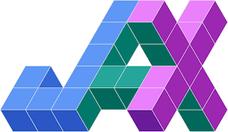


Challenge 3: Heterogenous Solution Tools
Constrained Optimization
Differential Equations
Supervised Learning
Reinforcement Learning
More domain knowledge
Less domain knowledge

Slide 9
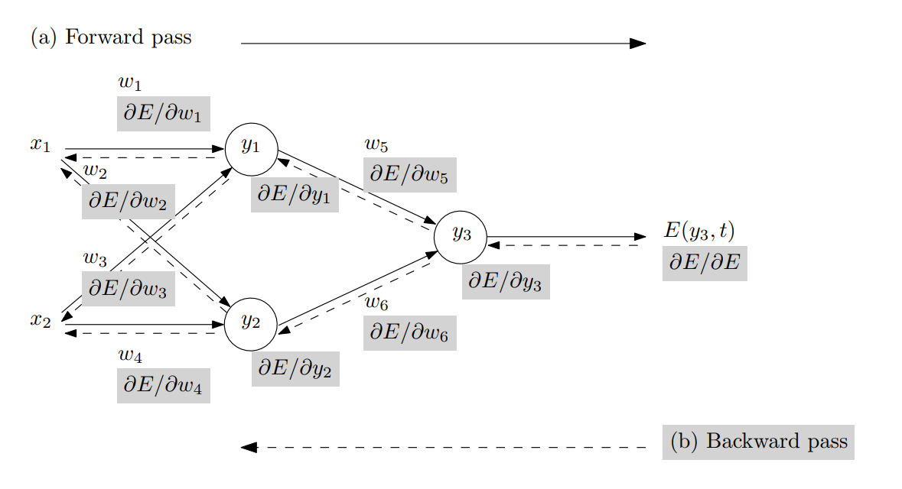
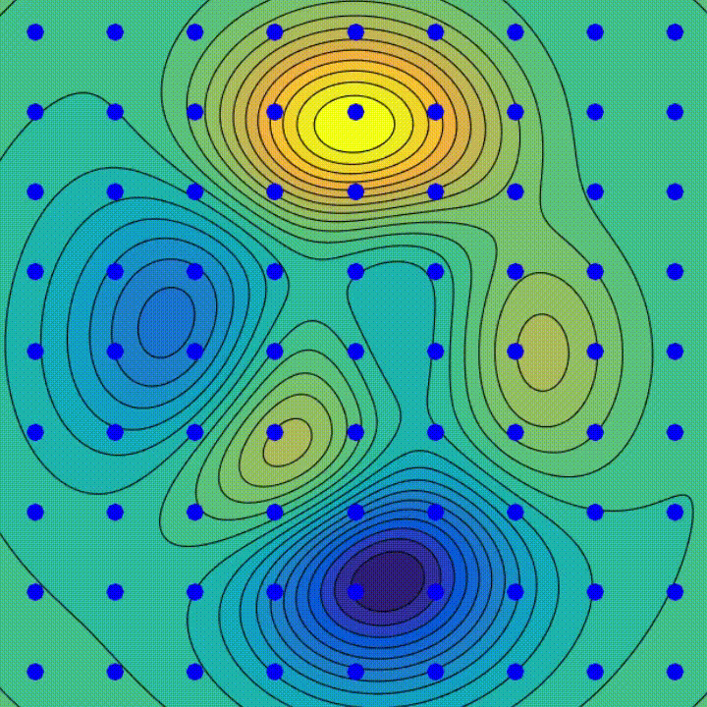
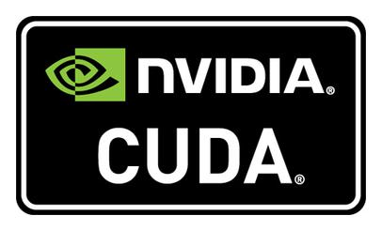

Automatic Differentiation (AD) in Machine Learning
AD enables efficient and accurate gradient computation, which is fundamental for training complex ML models using GPUs.
Backpropagation Algorithm
Gradient Descent Algorithm
SW and HW Innovations
Animation source: wikipedia
Baydin, Atilim Gunes et al. Automatic differentiation in machine learning: a survey. Journal of Machine Learning Research, 2015

Slide 10
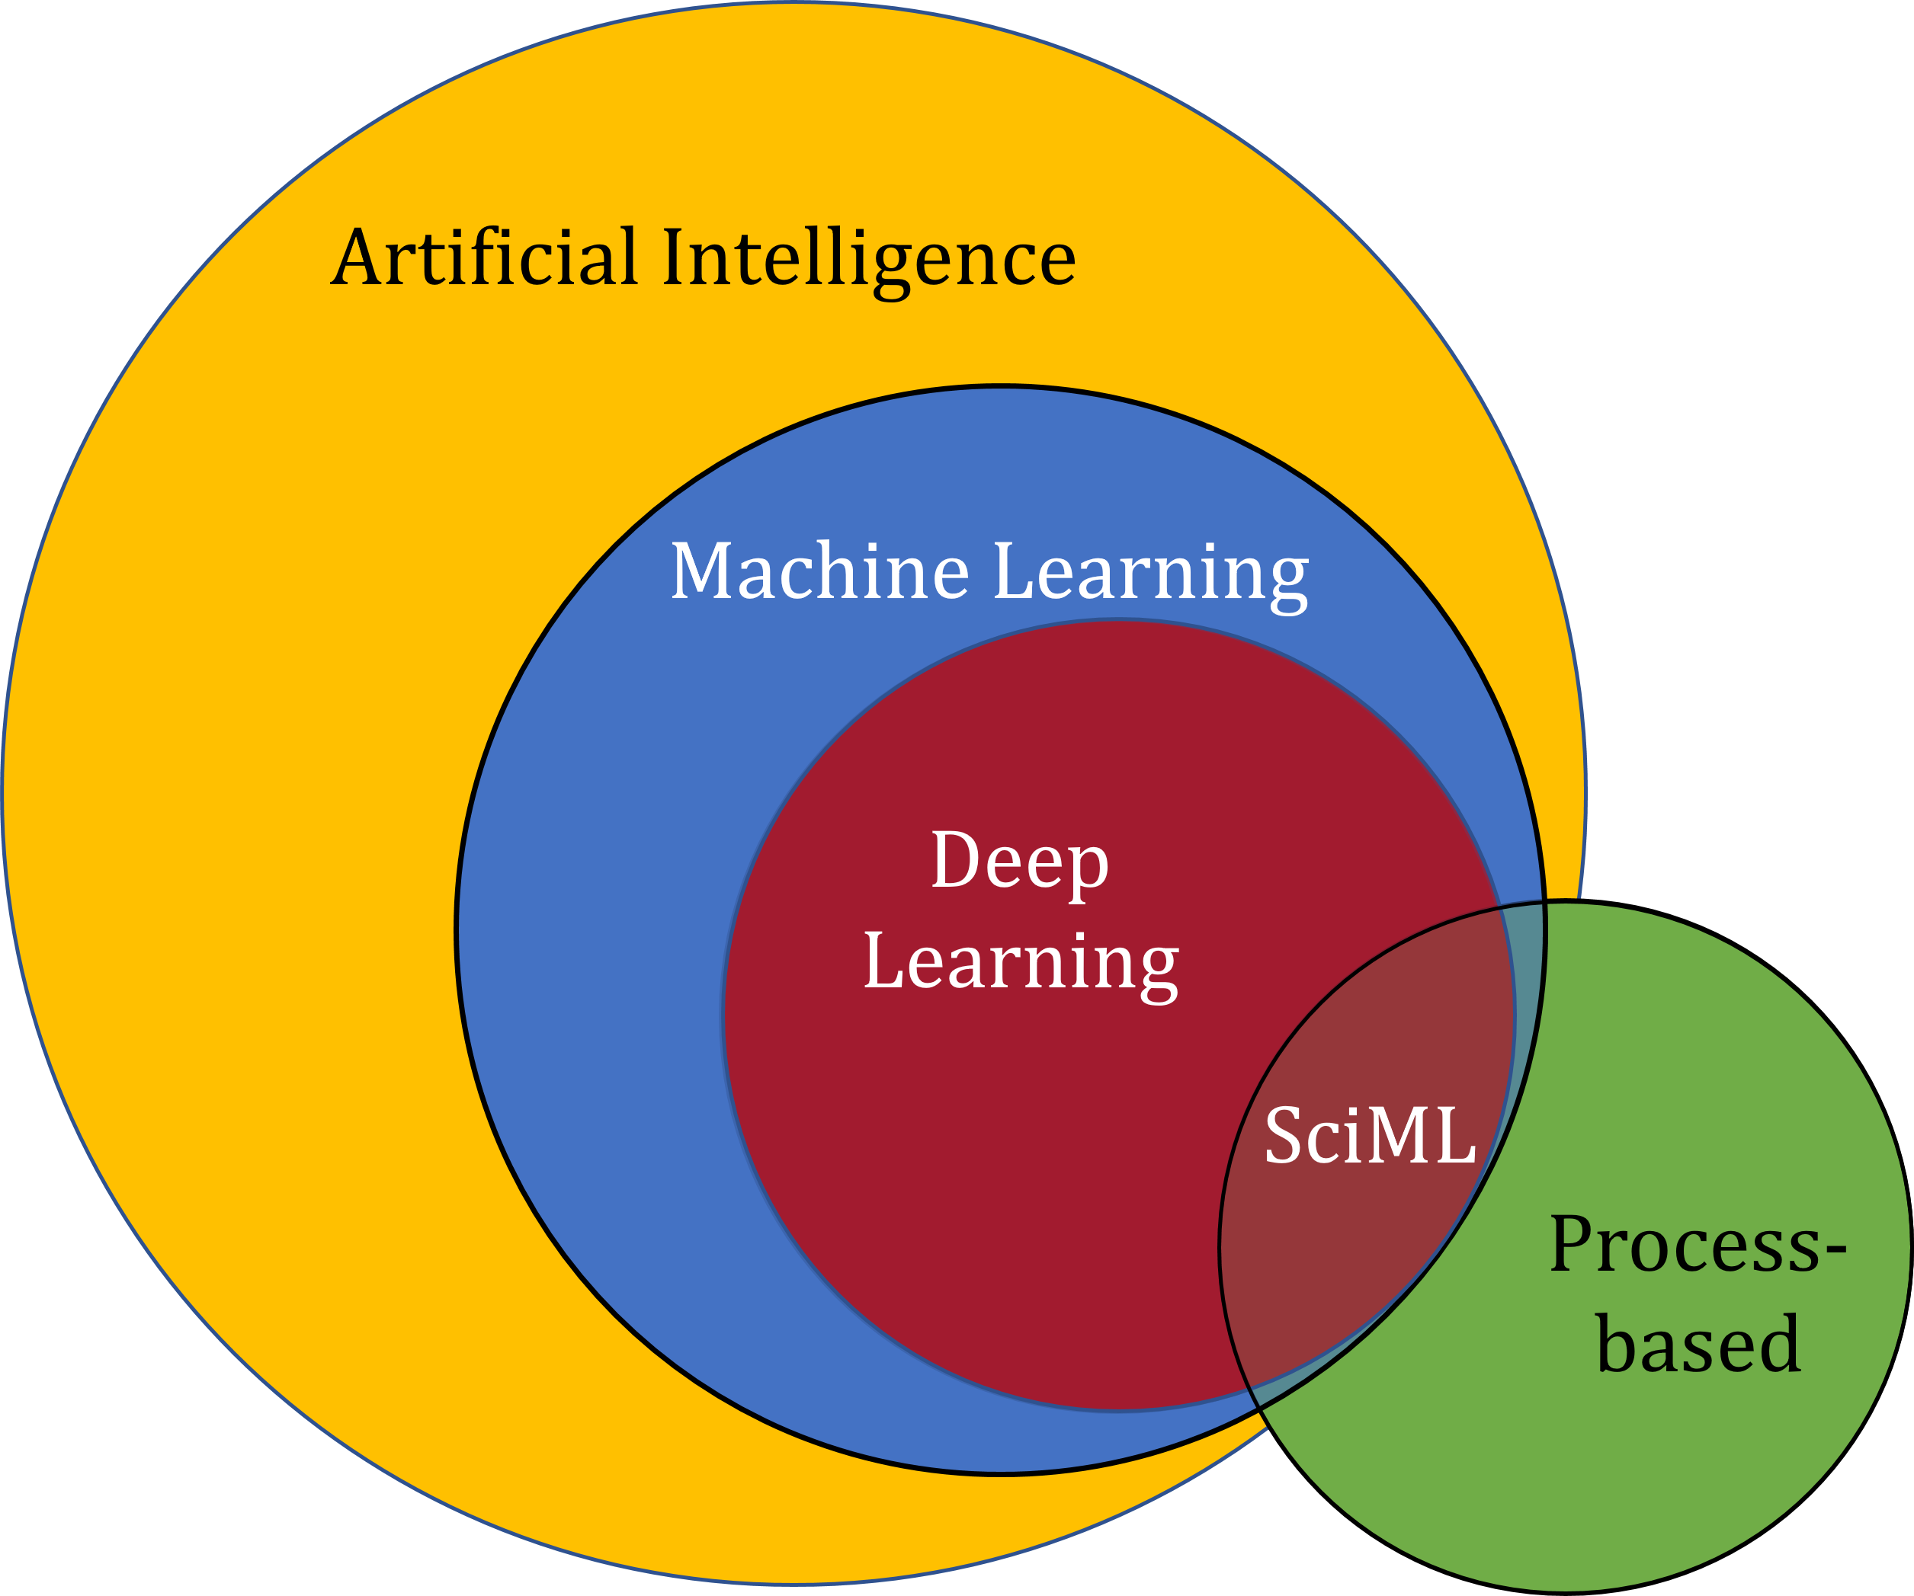
Scientific Machine Learning (SciML)
What?
SciML systematically integrates ML methods with mathematical models and algorithms developed in various scientific and engineering domains
Why?
Scientific applications are governed by fundamental principles and physical constraints
Purely data-driven “black box” ML methods cannot satisfy underlying physics
How?
Leverage automatic differentiation used in learning for modeling, optimization, and control
Karniadakis, G.E., Kevrekidis, I.G., Lu, L. et al. Physics-informed machine learning. Nat Rev Phys 3, 422–440, 2021.
Image source: https://sciml.wur.nl/reviews/sciml/sciml.html

Slide 11
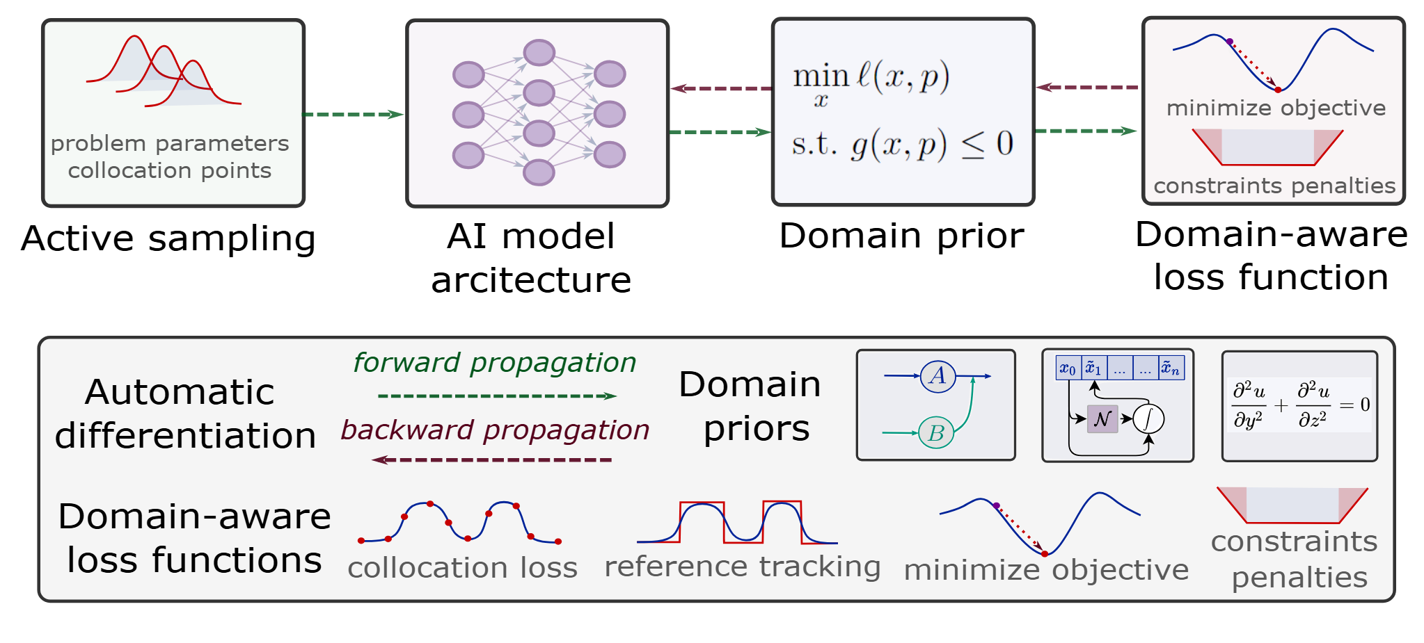
Components of Scientific Machine Learning
Karniadakis, G.E., Kevrekidis, I.G., Lu, L. et al. Physics-informed machine learning. Nat Rev Phys 3, 2021.
Thiyagalingam, J., Shankar, M., Fox, G. et al. Scientific machine learning benchmarks. Nature Reviews Physics 4, 413–420, 2022.
Nghiem T., Drgona J., et al. Physics-Informed Machine Learning for Modeling and Control of Dynamical Systems, ACC, 2023.

Slide 12

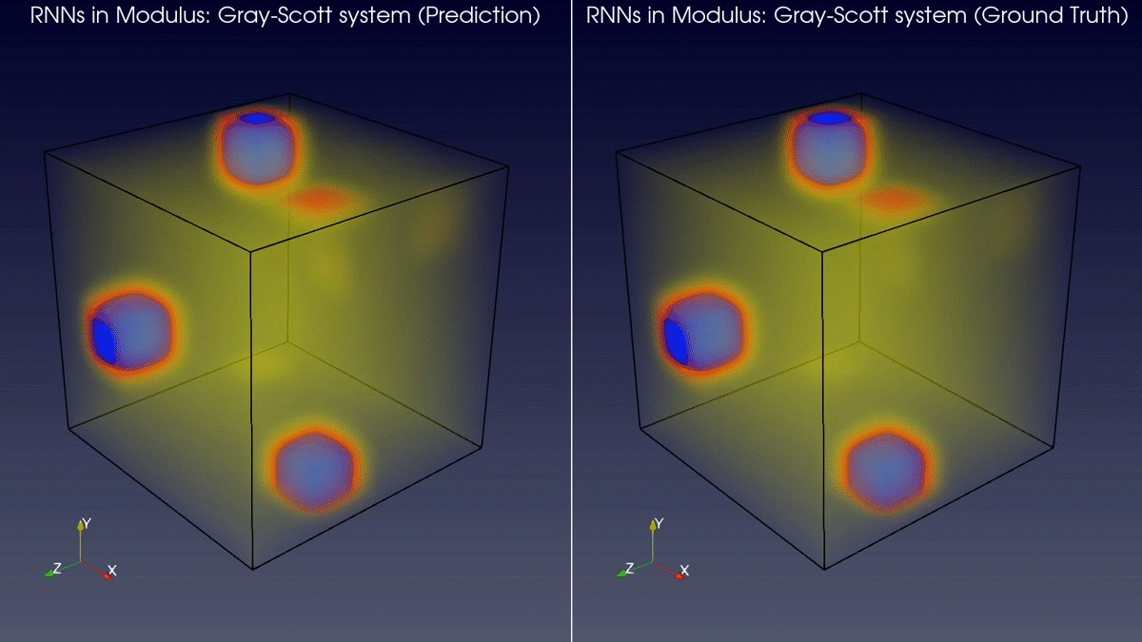
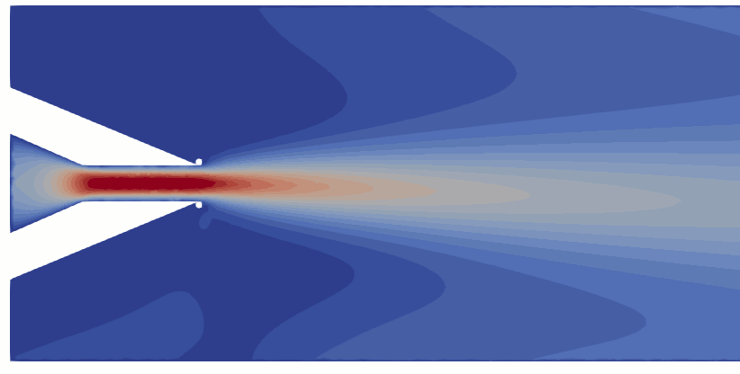
Learning to Solve Differential Equations with Physics-Informed Neural Networks (PINNs)
Training neural networks as PDE solutions
Application: Parameter estimation from data
M. Raissi, et al., Physics-informed neural networks: A deep learning framework for solving forward and inverse problems involving nonlinear partial differential equations, Journal of Computational Physics, 2019
Images: NVIDIA Modulus

Slide 13
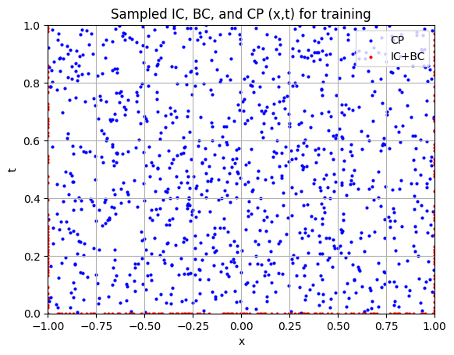
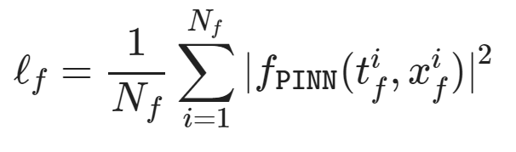
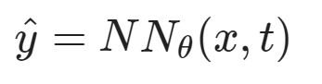
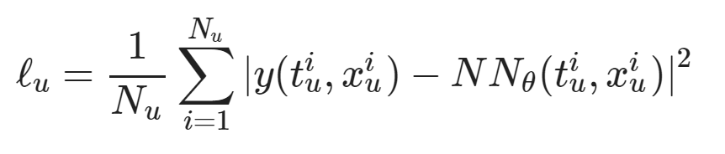
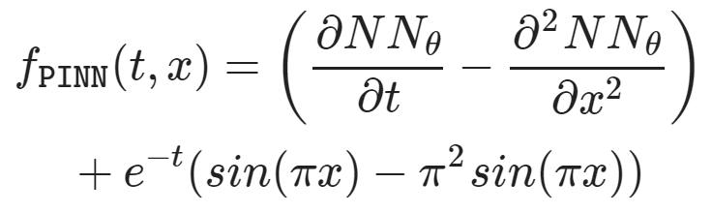
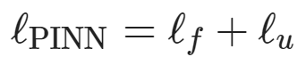
Learning to Solve Differential Equations with Physics-Informed Neural Networks (PINNs)
Dataset: collocation points in the spatio-temporal coordinates.
Architecture: PDE equations solved with neural network via automatic differentiation.
Loss function: minimizing PDE equation, initial and boundary condition residuals.
https://github.com/pnnl/neuromancer/blob/master/examples/PDEs/Part_2_PINN_BurgersEquation.ipynb
M. Raissi, et al., Physics-informed neural networks: A deep learning framework for solving forward and inverse problems involving nonlinear partial differential equations, Journal of Computational Physics, 2019

Slide 14
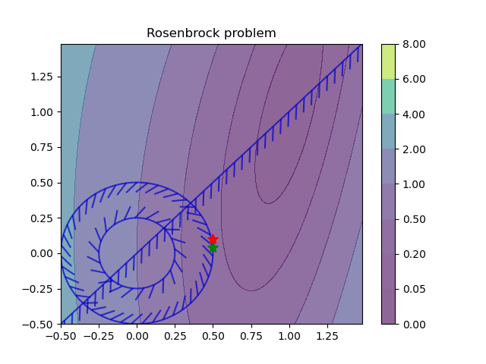
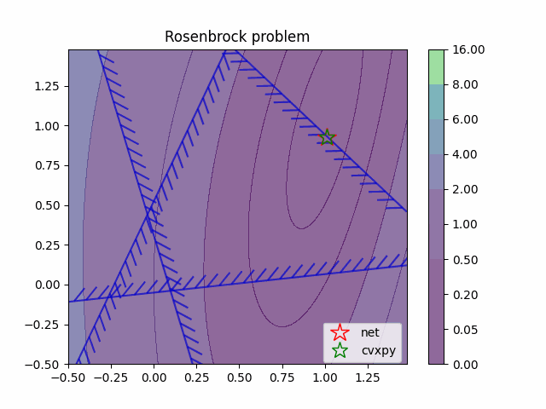
Learning to Optimize (L2O) with Constraints
Training neural networks as optimization solutions
Application: solving optimal power flow
James Kotary, et al., End-to-End Constrained Optimization Learning: A Survey, IJCAI, 2021

Slide 15
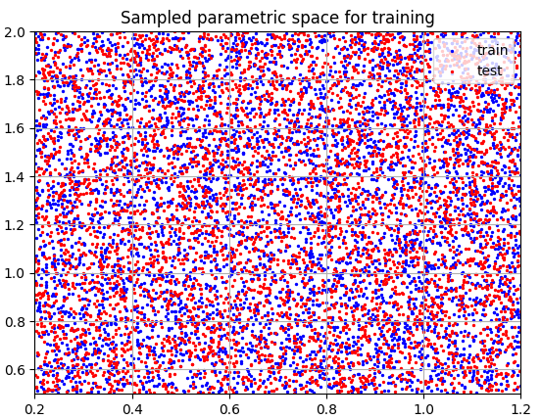
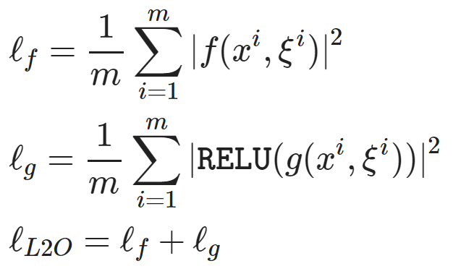
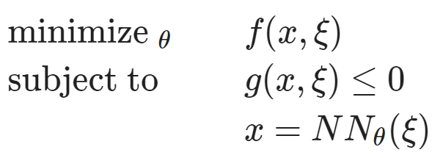
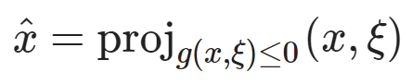
Learning to Optimize (L2O) with Constraints
Dataset: collocation points in the parametric space.
Architecture: differentiable optimization solver with neural network surrogate.
Loss function: minimizing objective function and constraints penalties.
https://github.com/pnnl/neuromancer/blob/master/examples/parametric_programming/Part_1_basics.ipynb
A. Agrawal, et al., Differentiable Convex Optimization Layers, 2019
P. Donti, et al., DC3: A learning method for optimization with hard constraints, 2021

Slide 16
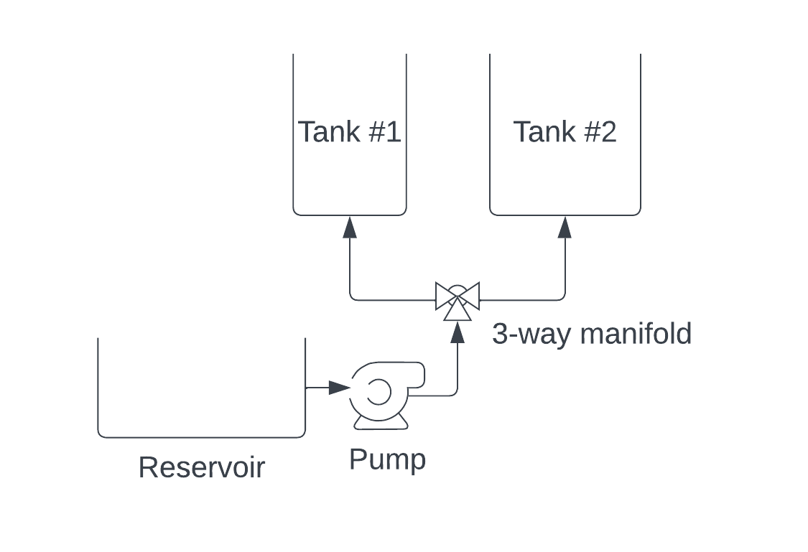
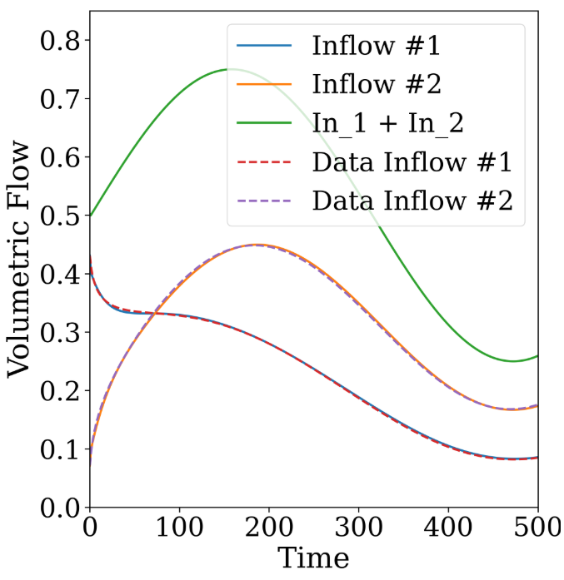
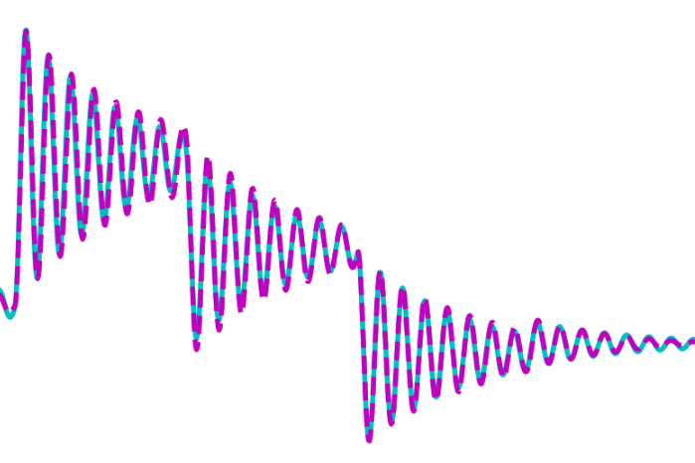
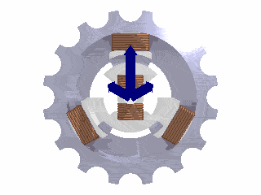
Learning to Model (L2M) Dynamical Systems
Nonlinear system identification
Applications: modeling process dynamics
R. T. Q. Chen, et al., Neural ordinary differential equations. NeurIPS, 2018
C. Rackauckas, et al., Universal Differential Equations for Scientific Machine Learning, 2021
James Koch, et al., Learning Neural Differential Algebraic Equations via Operator Splitting, CDC, 2025

Slide 17
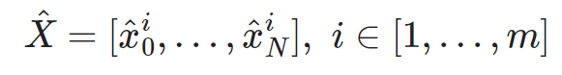
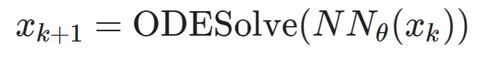
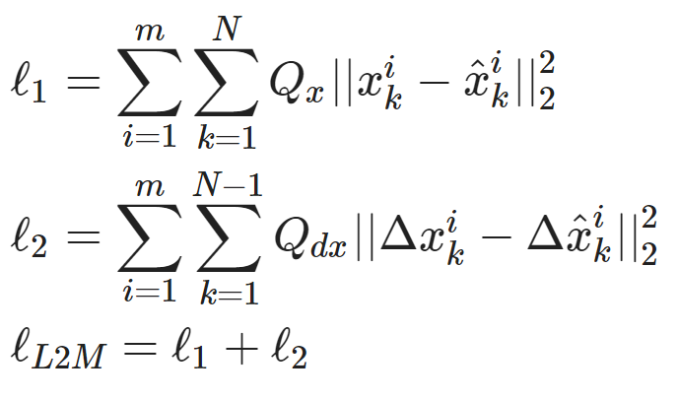
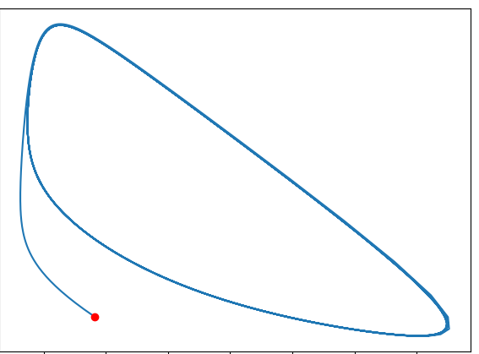
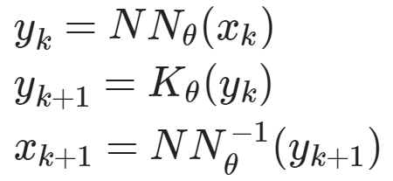
Learning to Model (L2M) Dynamical Systems
Dataset: time-series of states, inputs, and disturbances tuples.
Architecture: differentiable ODE solver with neural network model.
Loss function: trajectory matching, regularizations, and constraints penalties.
Architecture: Koopman operator with neural network basis functions.
https://github.com/pnnl/neuromancer/blob/master/examples/ODEs/Part_1_NODE.ipynb
R. T. Q. Chen, et al., Neural Ordinary Differential Equations, 2019
B. Lusch, et al., Deep learning for universal linear embeddings of nonlinear dynamics, 2018

Slide 18
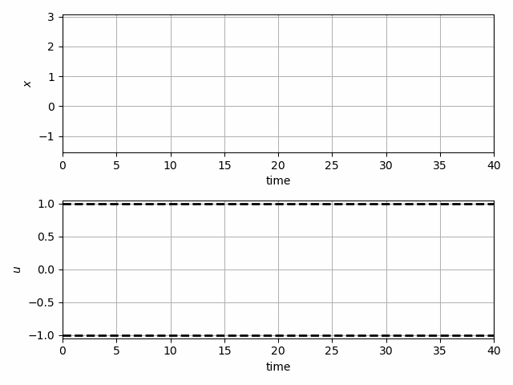
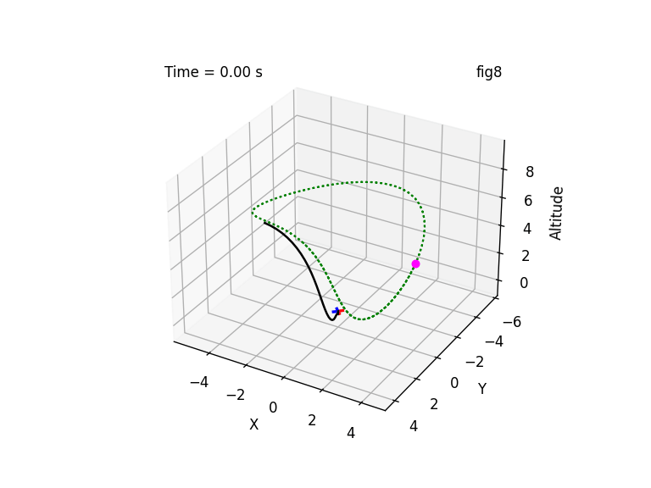
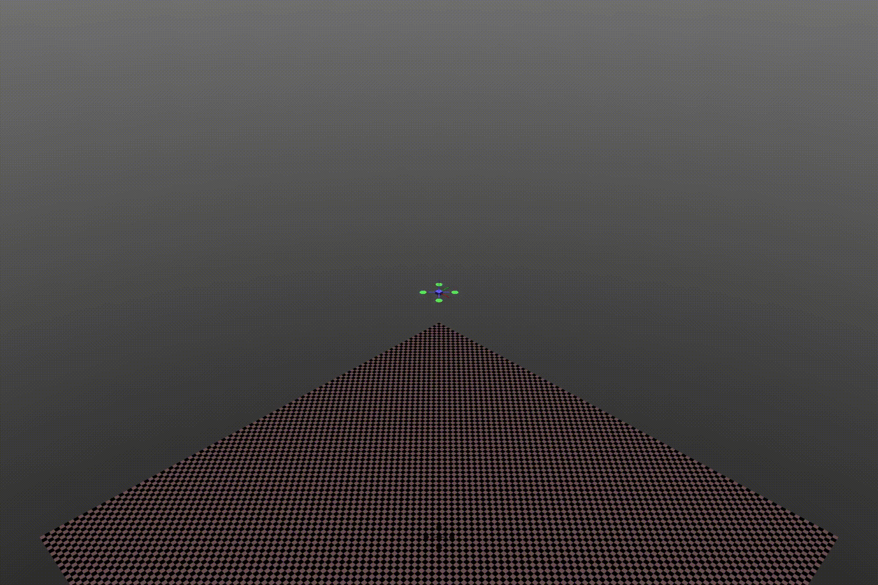
Learning to Control (L2C) via Differentiable Predictive Control (DPC)
Trajectory optimization for dynamical systems
Application: autonomous systems
J. Drgoňa, A. Tuor and D. Vrabie, "Learning Constrained Parametric Differentiable Predictive Control Policies With Guarantees," in IEEE Transactions on Systems, Man, and Cybernetics: Systems, 2024

Slide 19
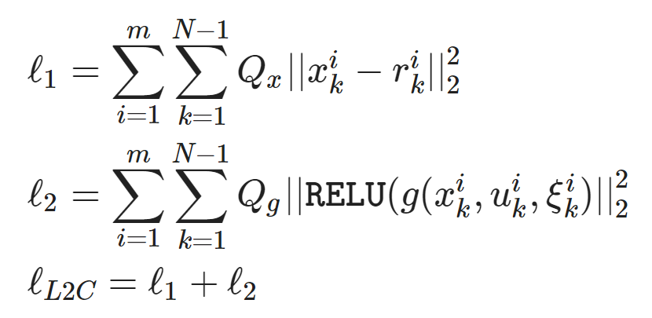
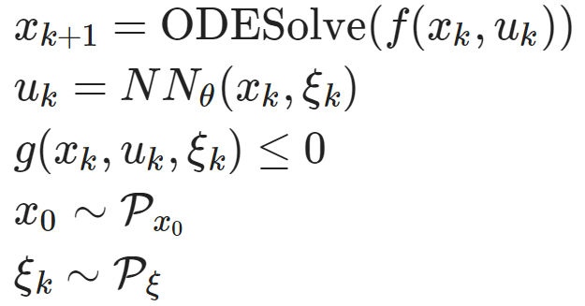
Learning to Control (L2C) via Differentiable Predictive Control (DPC)
Dataset: collocation points in the control parametric space.
Architecture: differentiable model with neural network control policy.
Loss function: reference tracking, constraints and terminal penalties.
https://github.com/pnnl/neuromancer/blob/master/examples/control/Part_3_ref_tracking_ODE.ipynb
J. Drgoňa, A. Tuor and D. Vrabie, "Learning Constrained Parametric Differentiable Predictive Control Policies With Guarantees," in IEEE Transactions on Systems, Man, and Cybernetics: Systems, 2024

Slide 20

NeuroMANCER Scientific Machine Learning Library
Open-source library in PyTorch
Physics-informed Neural Networks
Learning to optimize
Neural differential equations
Learning to control
github.com/pnnl/neuromancer

Slide 21
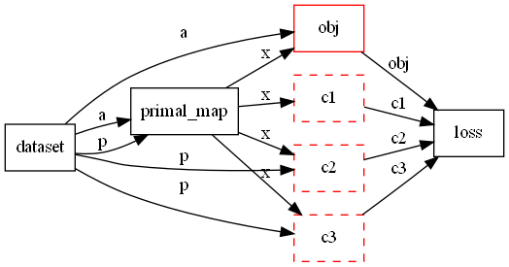
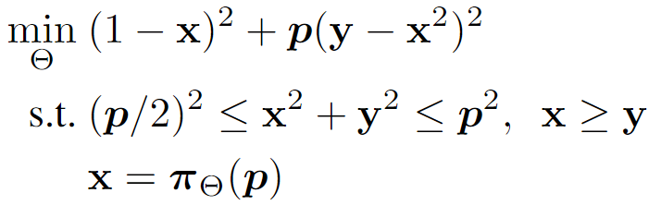
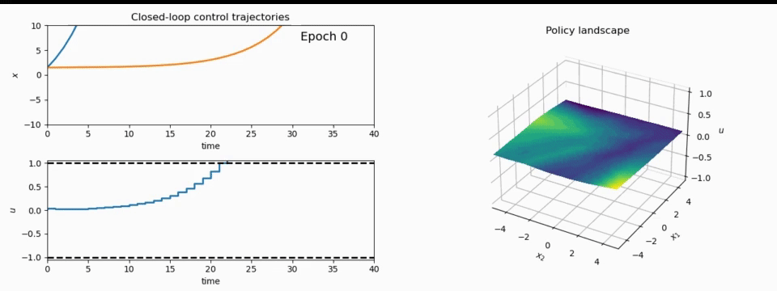
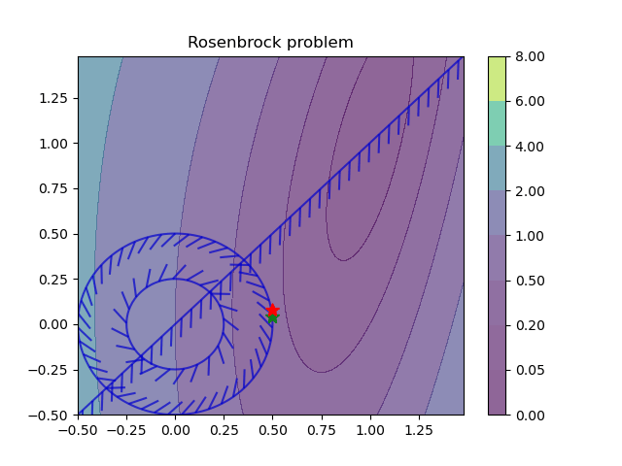
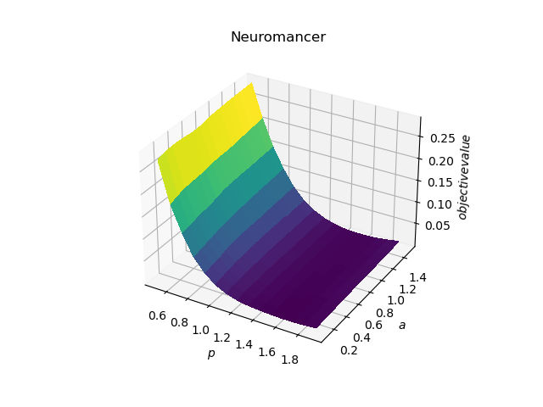
NeuroMANCER Scientific Machine Learning Library
1. Mathematical formulation
3. Problem graph
map
2. Python code interface
4. Results
import neuromancer as nm
p = nm.variable(‘p’)
x = nm.variable(‘x’)
y = nm.variable('y’)
obj = ((1-x)**2 + p*(y-x**2)**2).minimize(weight=1.0, name='obj’) c1 = (p/2)**2 <= x**2 + y**2
c2 = x**2 + y**2 <= p**2
c3 = x >= y net = nm.MLP(insize=2, outsize=2, hsizes=[80]*4) map = nm.Node(net, input_keys=['p’], output_keys=[‘x’,‘y’])
loss = nm.PenaltyLoss([obj], [c1, c2, c3]) problem = nm.Problem([map], loss)
optimizer = torch.optim.AdamW(problem.parameters()) trainer = nm.Trainer(problem,data,optimizer)
best_model = trainer.train()

Slide 22

Learning to Control Heating Ventilation and Air Conditioning (HVAC) Systems
Benefits of Scientific Machine Learning
Modeling and optimal control design is roughly 10-times faster and requires less expertise.
Real-time decisions are made orders of magnitude faster than traditional model-based approaches.
J. Drgona, et al., Physics-constrained deep learning of multi-zone building thermal dynamics, Energy and Buildings, 2021
J. Drgona, et al., Deep Learning Explicit Differentiable Predictive Control Laws for Buildings, IFAC NMPC 2021

Slide 23
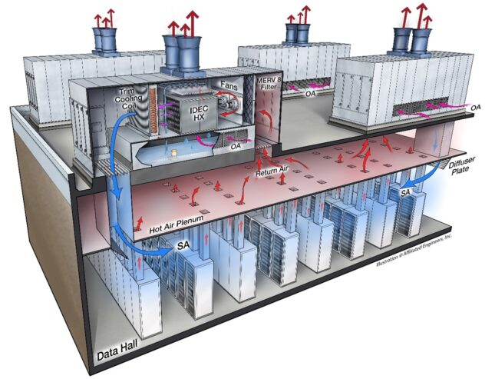
Remaining Challenges in Data Center Modeling and Control
High-fidelity digital twins of data centers require:
Scalable control-oriented surrogates to partial differential equations (PDEs)
Multi-physics and multi-scale modeling
Adaptive data-driven modeling
Handling energy and mass conservation laws
Optimal control of data centers require:
Handling of multi-objective tradeoffs such as grid-responsive and compute-aware objectives
Constraints satisfaction for safety and performance guarantees
Handling uncertainty and operational variability
Mixed-integer action spaces
Image from: https://www.csemag.com/using-fluid-technology-to-address-cooling-limitations-in-data-centers/

Slide 24

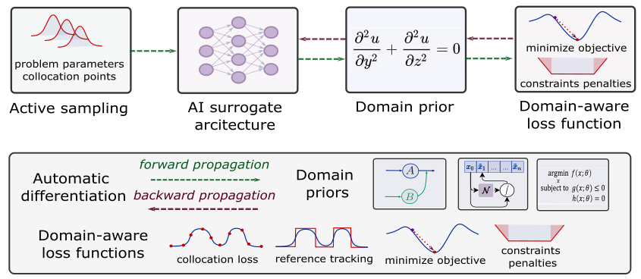
Summary
Scientific machine learning (SciML) methods integrating deep learning, constrained optimization, physics-based modeling, and control
Learning to solve (L2S)
Learning to optimize (L2O)
Learning to model (L2M)
Learning to control (L2C)
Challenges
Mixed-integer equality constraints
Gradients ill conditioning for deep graphs
Offline pre-training vs online adaptation
Computational cost of guarantees
Opportunities
Large-scale modeling, design, and control of data center operations
PDE optimization and control
Development of new software tools
drgona.github.io/
jdrgona1@jh.edu

